Slide 1


Foundation Model Assisted Automatic Speech Emotion Recognition: Transcribing, Annotating, and Augmenting
Signal Analysis and Interpretation Laboratory (SAIL)
Tiantian Feng, Shrikanth Narayanan
+
Notes:
Connections with thesis statements

Slide 2



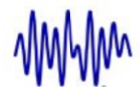


What are critical challenges to address in modern SER?
Speech
Computational Approaches
…
Computational Approaches?
Better Features?
Dataset and Annotations?
Notes:
Re-formulate the opening slide

Slide 3

Datasets and Annotations
Speech
Transcription
…
Emotion Labels

Slide 4
Can we automate these annotations?
Speech
Transcription
…
Emotion Labels

Slide 5
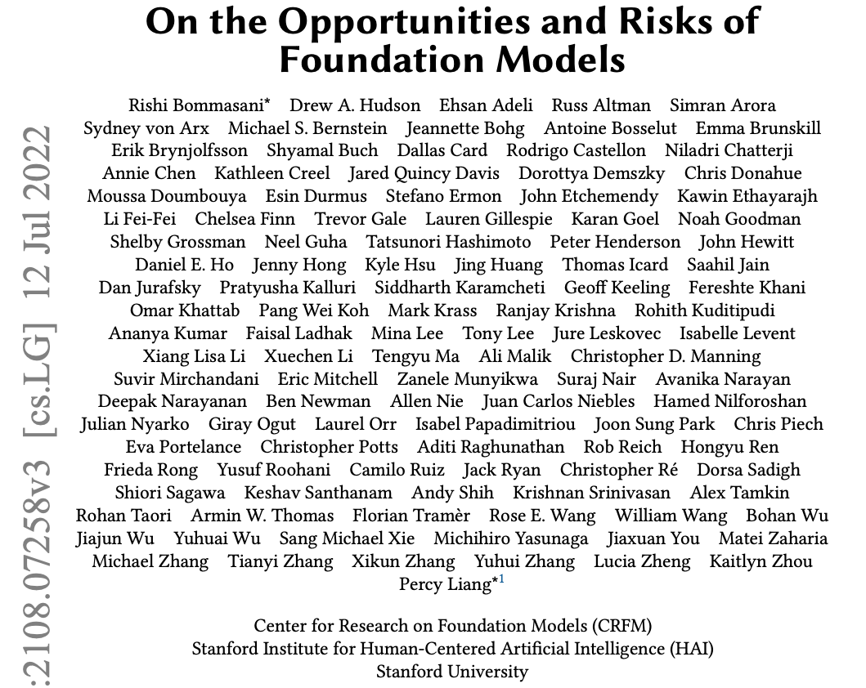
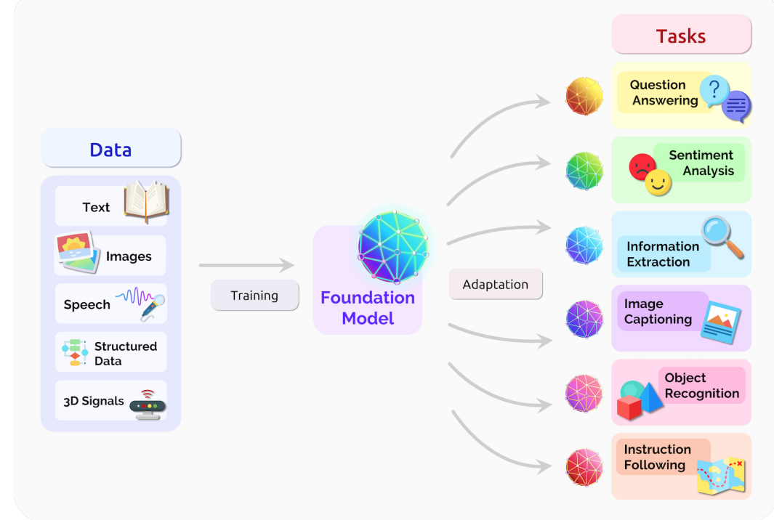
Promising Direction: Foundation Models
Bommasani, Rishi, et al. "On the opportunities and risks of foundation models." arXiv preprint arXiv:2108.07258 (2021).

Slide 6
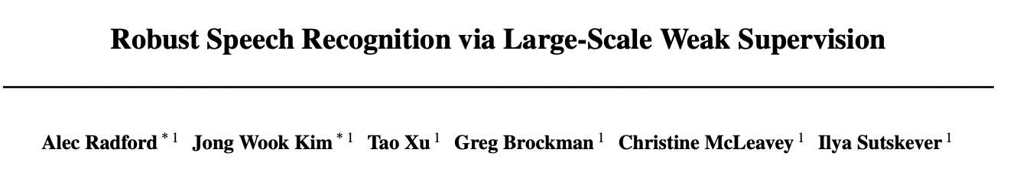
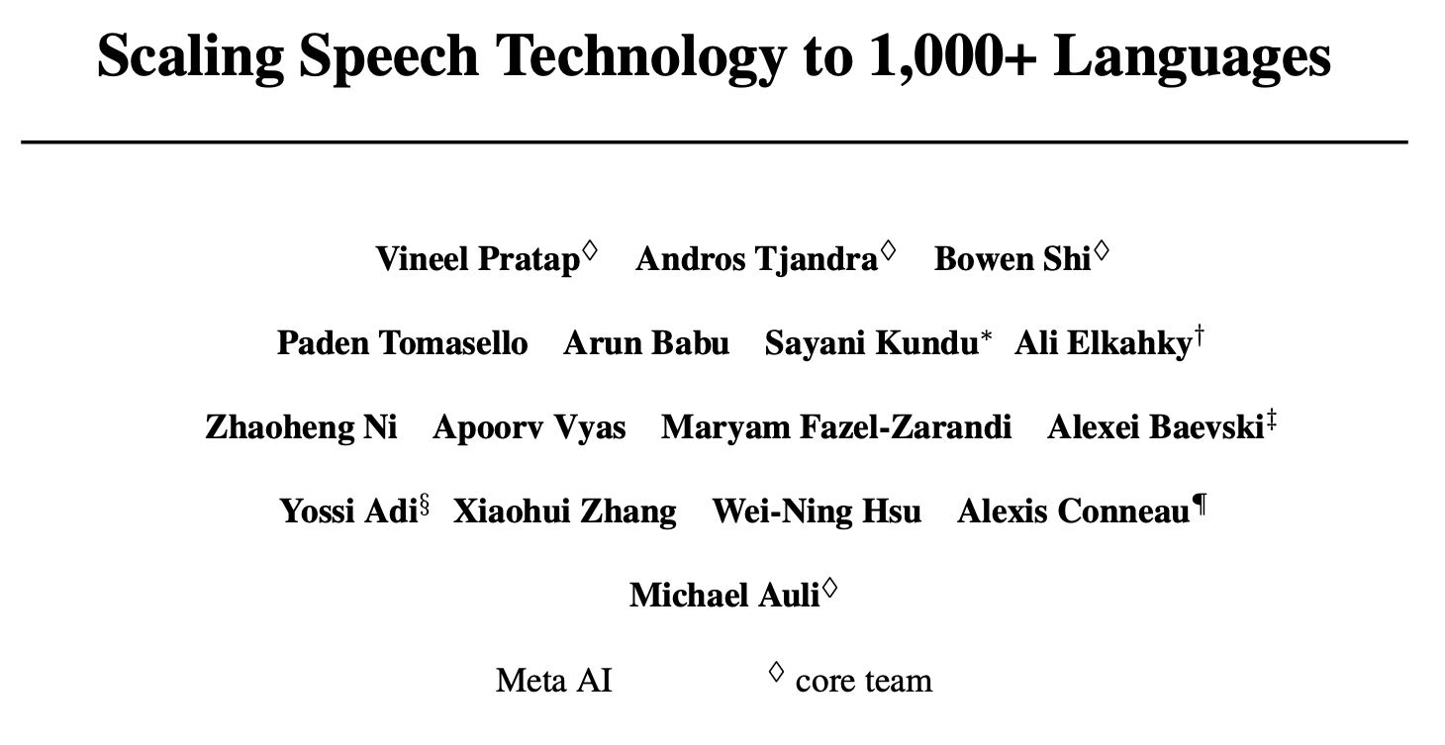
Era of (Speech) Foundation Models
Whisper
Radford, Alec, et al. "Robust speech recognition via large-scale weak supervision." International Conference on Machine Learning. PMLR, 2023.
MMS
Pratap, Vineel, et al. "Scaling speech technology to 1,000+ languages." arXiv preprint arXiv:2305.13516 (2023).

Slide 7
1st Research Question - Transcribing
Speech
ML System
…
Speech Foundation Models
Emotion Labels
Transcription
Can transcription from speech foundation models benefit SER?

Slide 8

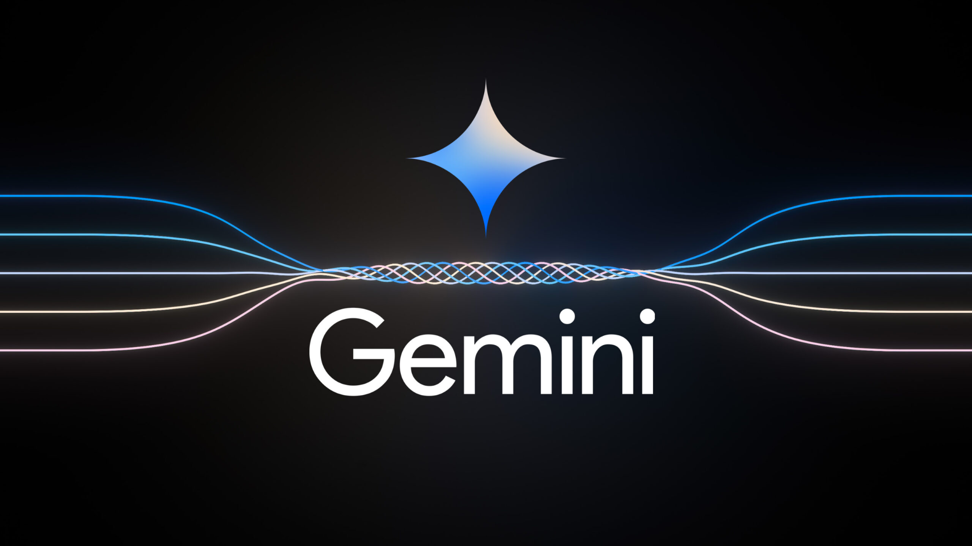

Era of Language Foundation Models
OpenAI - ChatGPT
Google - Gemini
Meta - LLaMa 2

Slide 9
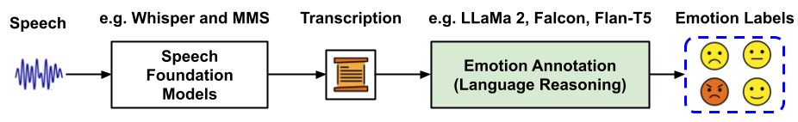
2nd Research Question - Emotion Labeling
Can language foundation models provide emotion labels from transcriptions?

Slide 10

3rd Research Question - Augmenting
Unlabeled Dataset
Labeled Dataset
Augment
Can foundation models provide annotations to unlabled dataset to augment labeled dataset ?

Slide 11
1st Research Question - Transcribing
Speech
ML System
…
Speech Foundation Models
Emotion Labels
Transcription
Can transcription from speech foundation models benefit SER?

Slide 12
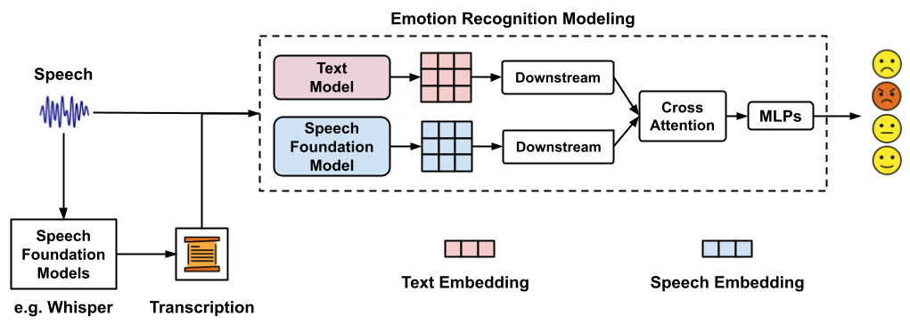
SER Modeling

Slide 13
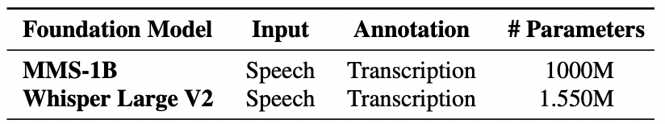
SER Modeling

Slide 14
SER Modeling
We use RoBERTa as the text model
Liu, Yinhan, et al. "Roberta: A robustly optimized bert pretraining approach." arXiv preprint arXiv:1907.11692 (2019).

Slide 15
SER Modeling
We use the groundtruth (human) transcription when performing test
Liu, Yinhan, et al. "Roberta: A robustly optimized bert pretraining approach." arXiv preprint arXiv:1907.11692 (2019).

Slide 16
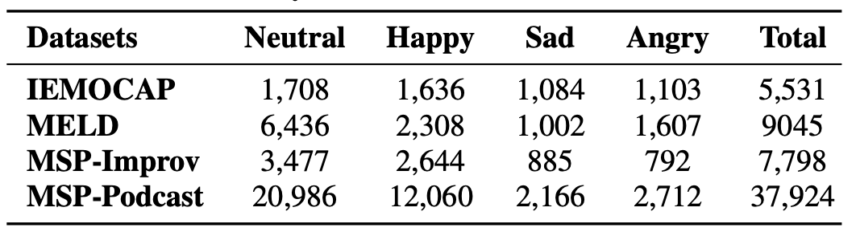
SER Datasets
We report the performance using UAR (unweighted average recall)
Busso, Carlos, et al. "IEMOCAP: Interactive emotional dyadic motion capture database." Language resources and evaluation 42 (2008): 335-359.
Poria, Soujanya, et al. "Meld: A multimodal multi-party dataset for emotion recognition in conversations." arXiv preprint arXiv:1810.02508 (2018).
Busso, Carlos, et al. "MSP-IMPROV: An acted corpus of dyadic interactions to study emotion perception." IEEE Trans. on Affective Computing 8.1 (2016).
Lotfian, Reza, and Carlos Busso. "Building naturalistic emotionally balanced speech corpus by retrieving emotional speech from existing podcast recordings." IEEE Transactions on Affective Computing 10.4 (2017): 471-483.

Slide 17
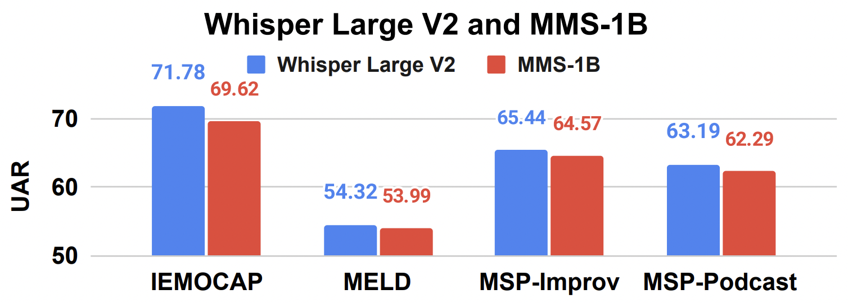
Comparisons Between Speech Foundation Models
SER Performance
Whisper outperforms MMS in transcribing for SER

Slide 18
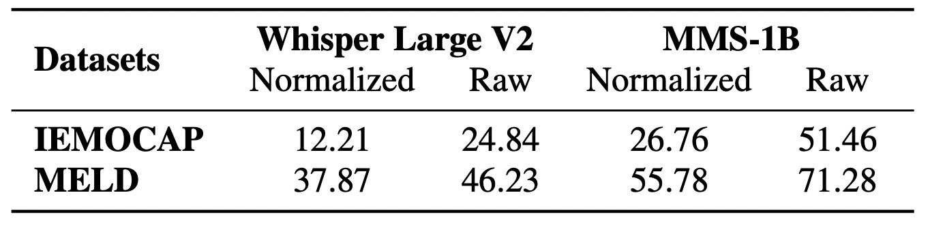
Comparisons Between Speech Foundation Models
WER (word error rate) in transcriptions. Normalized transcripts consider only lowercase and remove punctuation.
Whisper outperforms MMS in transcribing

Slide 19
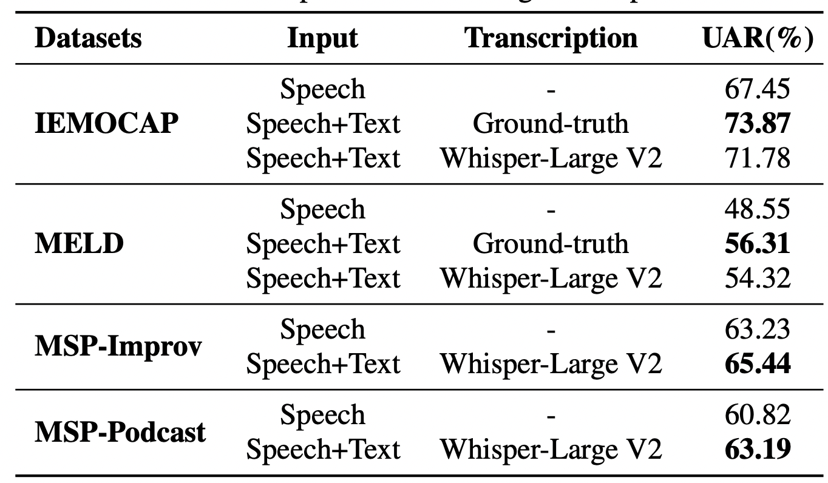
ASR With Speech Foundation Models Benefits SER
Speech Foundation Models provide transcription that enhances SER performance compared to those without
Notes:
Make the tabel larger

Slide 20
ASR Underperforms Human Transcriptions
Human transcriptions still yields higher SER performance than those from speech foundation models

Slide 21
Full Results

Slide 22
2nd Research Question - Emotion Labeling
Can language foundation models provide emotion labels from transcriptions?

Slide 23
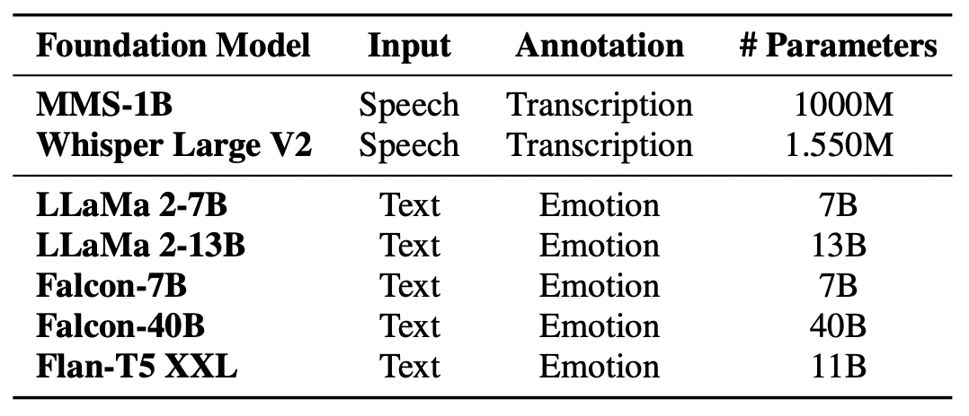
2nd Research Question - Emotion Labeling
Touvron, Hugo, et al. "Llama 2: Open foundation and fine-tuned chat models." arXiv preprint arXiv:2307.09288 (2023).
https://huggingface.co/blog/falcon#the-falcon-models
Chung, Hyung Won, et al. "Scaling instruction-finetuned language models." arXiv preprint arXiv:2210.11416 (2022).

Slide 24
Base Prompt with Single LLM
What is the emotion of this utterance?
”Everything is not working!”
Options:
-neutral
-sad
-angry
-happy
-other
ANSWER: sad
We discard speech samples with label of other in SER modeling

Slide 25
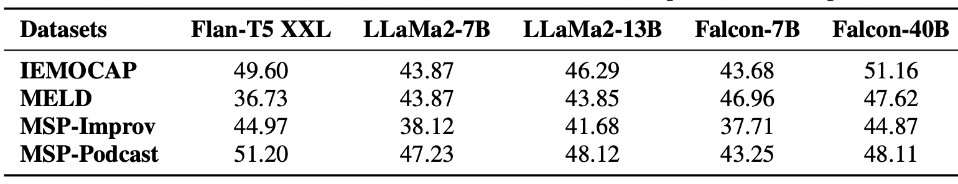
Results - Base Prompt with Single LLM
All LLM-based emotion annotations provide low SER performance

Slide 26
Results - Base Prompt with Single LLM
Larger LLMs provide better emotion annotations than smaller ones

Slide 27
Multiple LLMs - Mixture of Experts Agreement
LLM1
Happy
LLM1
Happy
Sad
Sad
LLM2
Sad
LLM2
Other
LLM3
Sad
LLM3
Neutral
We use FLAN-XXL, LLaMa2-13B, Falcon-40B in this experiment

Slide 28
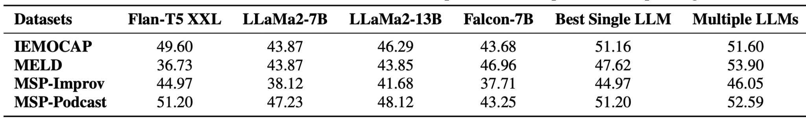
Results - Multiple LLMs
Multiple LLMs outperforms single LLM but still provides lower overall SER performance

Slide 29
Multiple LLMs with Human Feedback (Agreement)
LLM1
Happy
LLM1
Happy
Sad
Sad
LLM2
Sad
Sad
LLM2
Sad
Other
LLM3
Sad
LLM3
Sad
Sad
Neutral
Human Annotation
Human Annotation
Human Agrees with Multiple LLMs
Human disagrees with Multiple LLMs

Slide 30
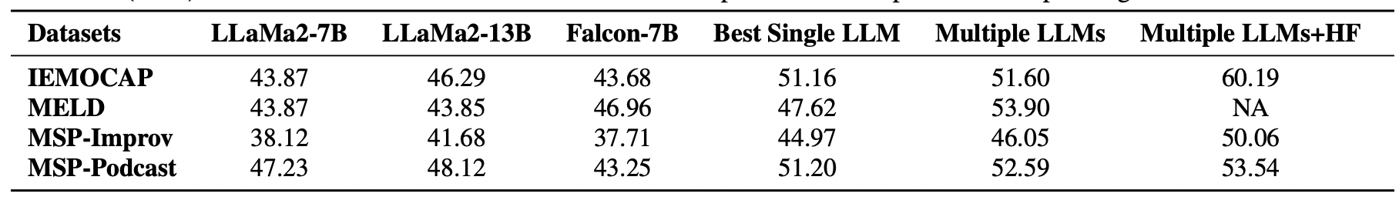
Results - Multiple LLMs with Human Feedback
Multiple LLMs with human feedback yields moderate SER performance

Slide 31
Results - Multiple LLMs with Human Feedback
Overall, the emotion annotation with LLMs is still challenging, with decreased SER performances for about 10% UAR compared to using groundtruth annotations

Slide 32
3rd Research Question - Augmentation
Unlabeled Dataset
Labeled Dataset
Augment
Can foundation models provide annotations to unlabled dataset to augment labeled dataset ?

Slide 33
3rd Research Question - Augmentation
Unlabeled Dataset
Labeled Dataset
Augment
We use multiple LLMS and multiple LLMs with human agreemetn as the annotation approaches

Slide 34
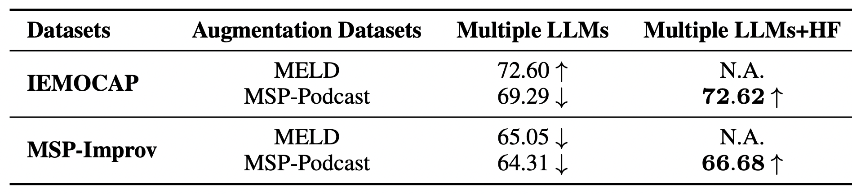
3rd Research Question - Augmentation
IEMOCAP without augmentation: 71.78
MSP-Improv without augmentation: 63.19
Multiple LLMs cannot provide annotations on unlabeled speech samples to augment existing curated SER datasets

Slide 35
3rd Research Question - Augmentation
IEMOCAP without augmentation: 71.78
MSP-Improv without augmentation: 63.19
Multiple LLMs with human feedback can be used to provide augmented samples to existing curated SER datasets

Slide 36
Key Takeaways
Foundation Model Assisted SER
Provide transcription for Training SER
Provide emotion annotations from transcriptions for training SER
Annotate unlabeled samples to augment existing curated SER datasets

Slide 37
Key Takeaways
Foundation Model Assisted SER
Provide transcription for Training SER
Provide emotion annotations from transcriptions for training SER
Annotate unlabeled samples to augment existing curated SER datasets

Slide 38
Thanks!
Questions?
Notes:
Focus: compress TILES contents
On more connecting privacy->trust ()
Simplify
Ani

Slide 39
Speech Emotion Recognition (SER)
Speech
Computational Approaches
…

Slide 40
Speech Emotion Recognition Solutions
Knowledge-based Features
(e.g. OpenSMILE-derived features)
Speech
…
Pre-trained Models
(e.g. Wav2vec 2.0)
…

Slide 41
Speech Emotion Recognition Solutions
Knowledge-based Features
(e.g. OpenSMILE-derived features)
Speech
…
Pre-trained Models
(e.g. Wav2vec 2.0)
…

